Slide 1
Graphs

Slide 2
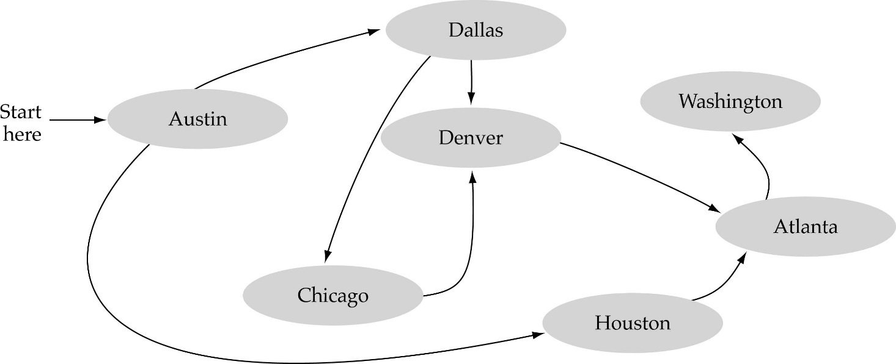
What is a graph?
A data structure that consists of a set of nodes (vertices) and a set of edges that relate the nodes to each other
The set of edges describes relationships among the vertices

Slide 3
Formal definition of graphs
A graph G is defined as follows:
G=(V,E)
V(G): a finite, nonempty set of vertices
E(G): a set of edges (pairs of vertices)

Slide 4
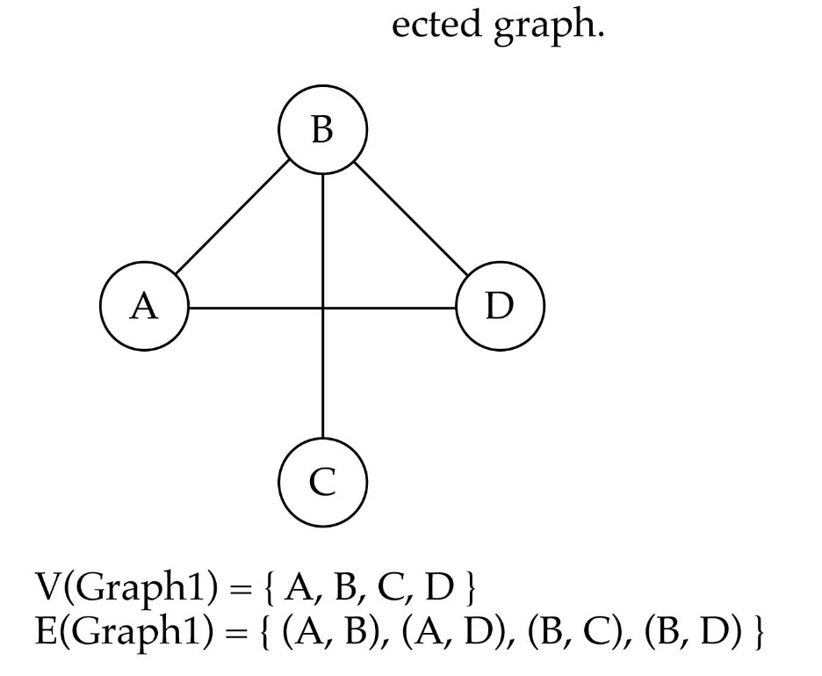
Directed vs. undirected graphs
When the edges in a graph have no direction, the graph is called undirected

Slide 5
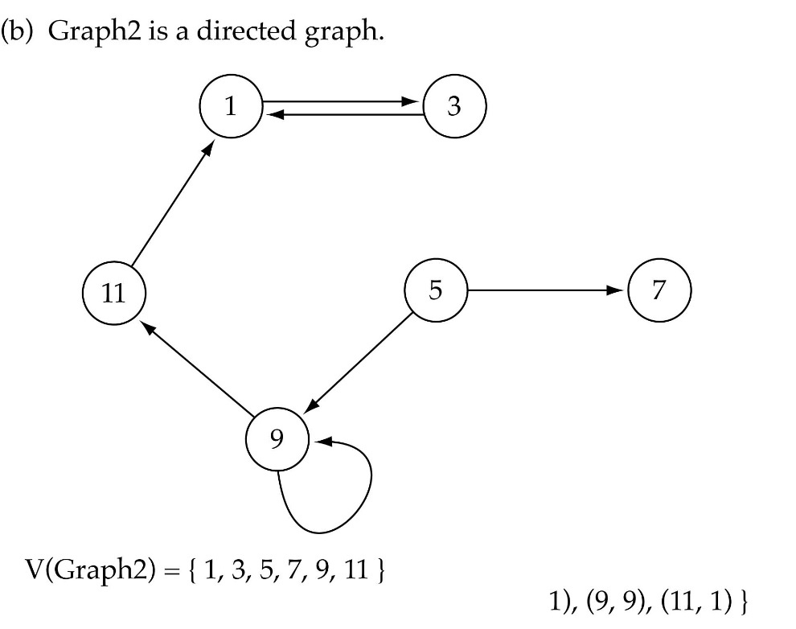
Directed vs. undirected graphs (cont.)
When the edges in a graph have a direction, the graph is called directed (or digraph)
Warning: if the graph is directed, the order of the vertices in each edge is important !!
E(Graph2) = {(1,3) (3,1) (5,9) (9,11) (5,7)

Slide 6
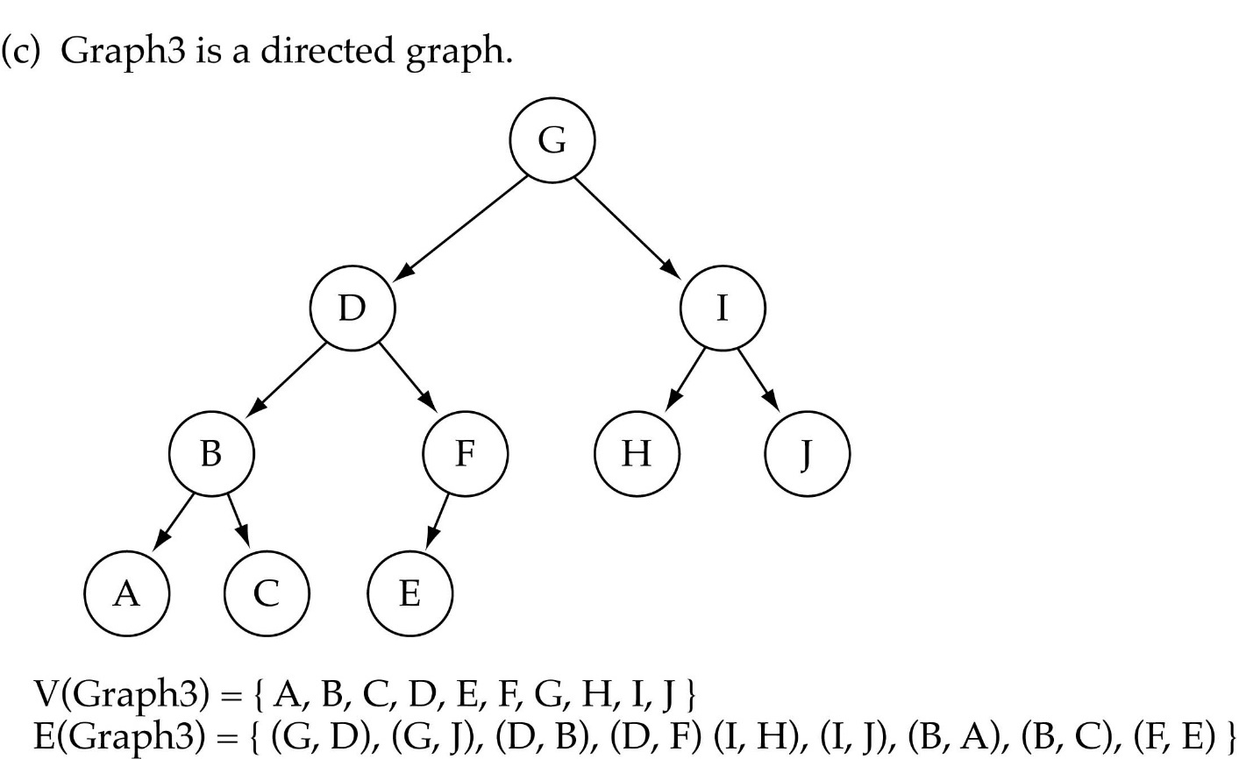
Trees vs graphs
Trees are special cases of graphs!!

Slide 7
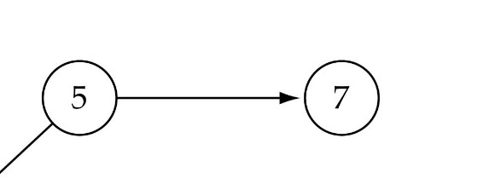
Graph terminology
Adjacent nodes: two nodes are adjacent if they are connected by an edge
Path: a sequence of vertices that connect two nodes in a graph
Complete graph: a graph in which every vertex is directly connected to every other vertex
5 is adjacent to 7
7 is adjacent from 5

Slide 8
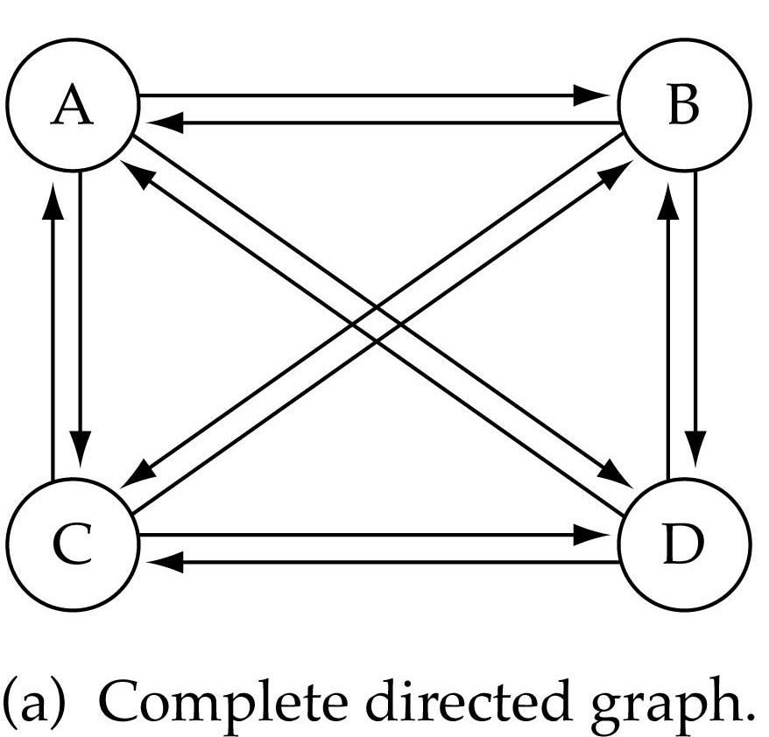
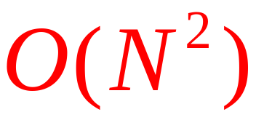
Graph terminology (cont.)
What is the number of edges in a complete directed graph with N vertices?
N * (N-1)

Slide 9
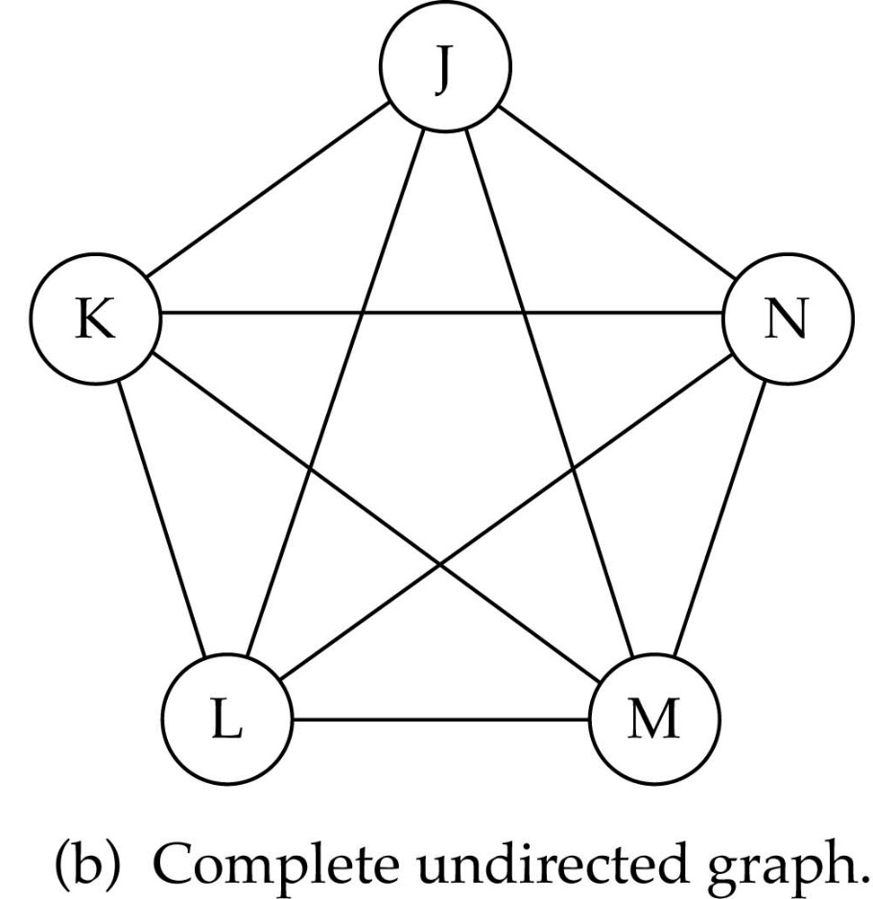
Graph terminology (cont.)
What is the number of edges in a complete undirected graph with N vertices?
N * (N-1) / 2

Slide 10
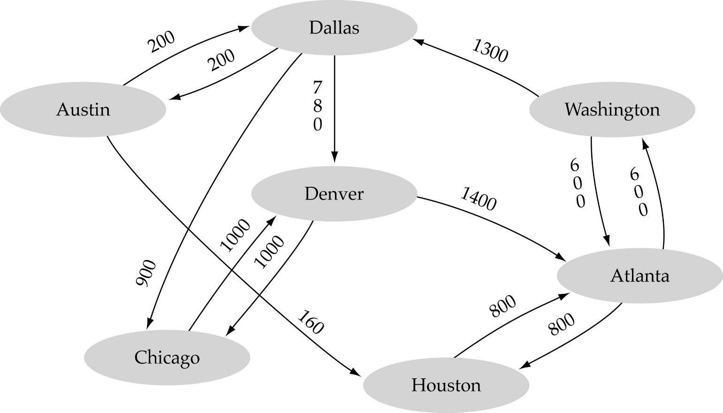
Graph terminology (cont.)
Weighted graph: a graph in which each edge carries a value

Slide 11

Graph implementation
Array-based implementation
  A 1D array is used to represent the vertices
  A 2D array (adjacency matrix) is used to represent the edges

Slide 12
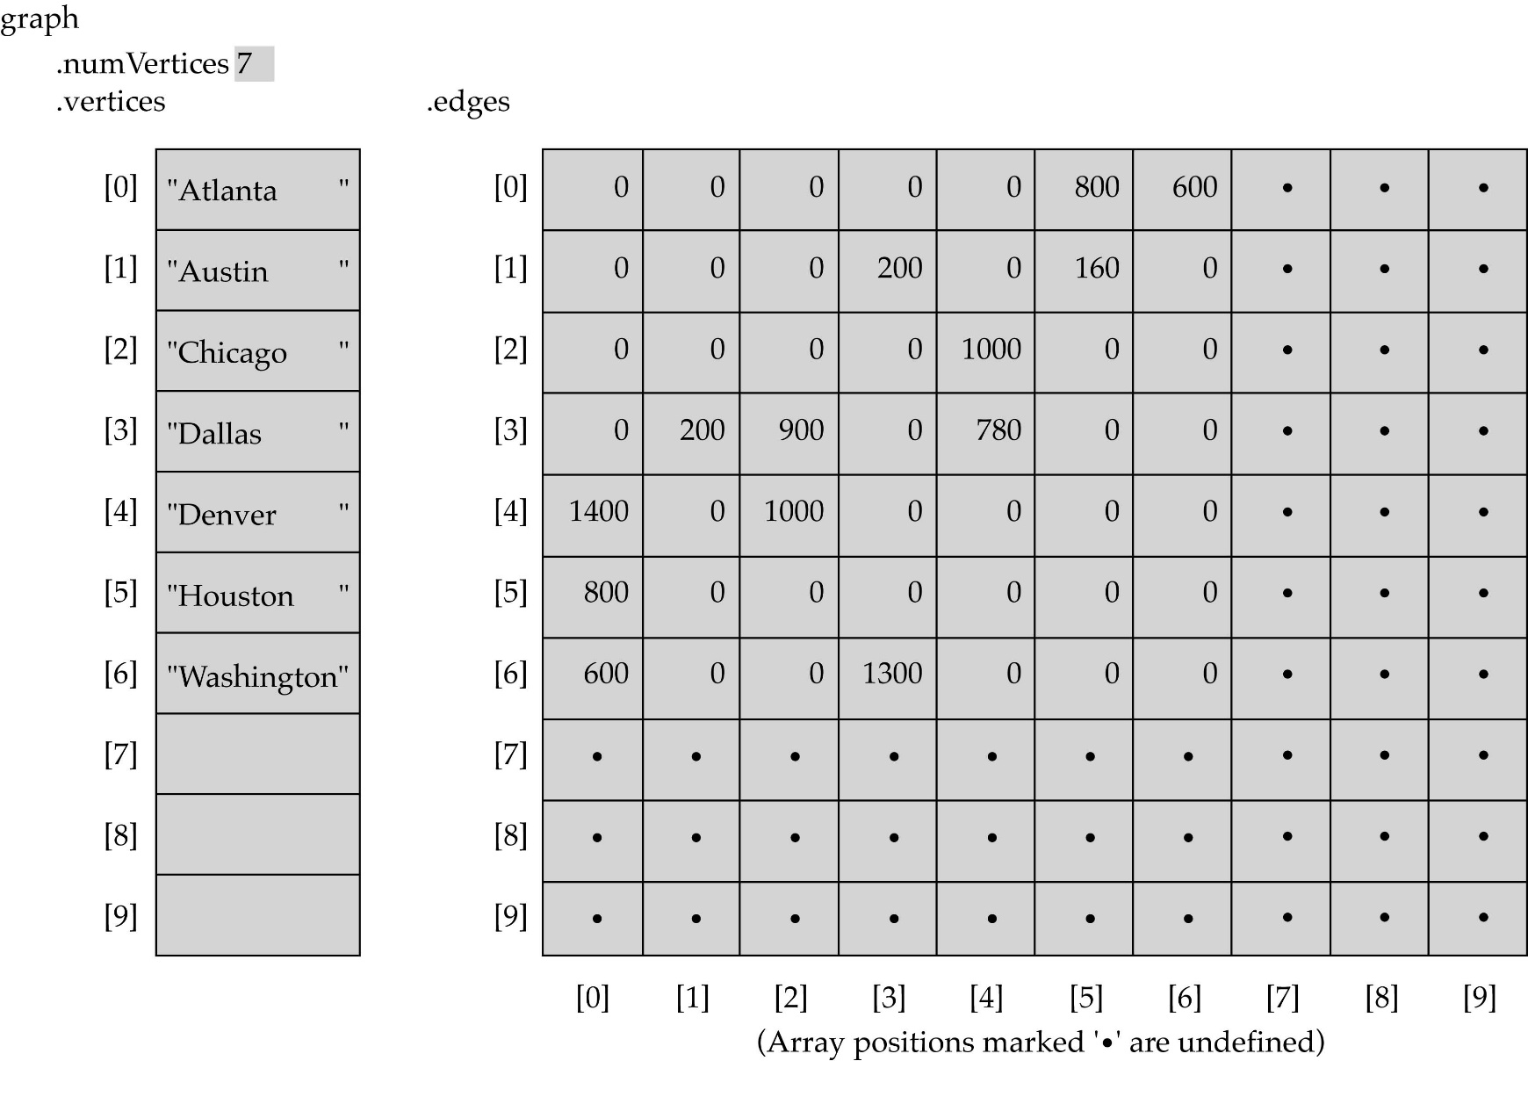
Array-based implementation

Slide 13

Graph implementation (cont.)
Linked-list implementation
  A 1D array is used to represent the vertices
  A list is used for each vertex v which contains the vertices which are adjacent from v (adjacency list)

Slide 14
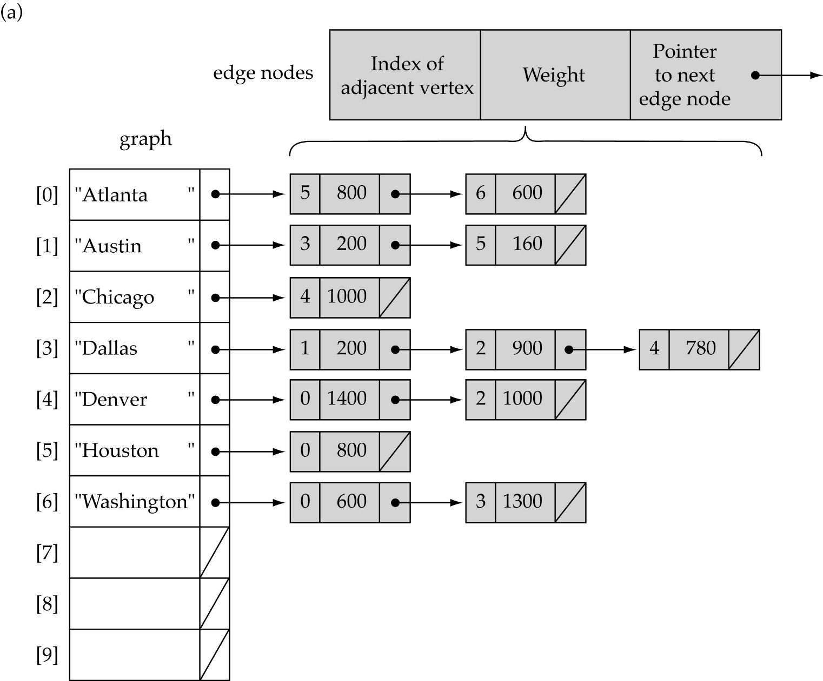
Linked-list implementation

Slide 15
Adjacency matrix vs. adjacency list representation
Adjacency matrix
  Good for dense graphs --|E|~O(|V|²)
  Memory requirements: O(|V| + |E| ) = O(|V|² )
  Connectivity between two vertices can be tested quickly
Adjacency list
  Good for sparse graphs -- |E|~O(|V|)
  Memory requirements: O(|V| + |E|)=O(|V|)
  Vertices adjacent to another vertex can be found quickly

Slide 16
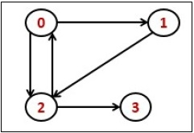
Transitive Closure
Transitive Closure it the reachability matrix to reach from vertex u to vertex v of a graph. One graph is given, we have to find a vertex v which is reachable from another vertex u, for all vertex pairs (u, v).

Slide 17
Warshall's algorithm
Warshall's algorithm calculates the transitive closure by generating
a sequence of n matrices, where n is the number of vertices.
R⁽⁰⁾, ..., R^{(k-1)}, R^{(k)}, ... , R^{(n)}
The R⁽⁰⁾ matrix represent paths without any intermediate vertices, so it is the adjacency matrix. The R^{(n)} matrix has ones if there is a path between the vertices with intermediate vertices from any of the n vertices of the graph, so it is the transitive closure.
Consider the case r_{ij}^{(k)} is one and r_{ij}^{(k-1)} = 0. This can occur only if that there is an intermediate path through v_{k} from from v_{i} to v_{j}. More specifically the list of vertices has the form
v_{i}, w_{q} (where 1 ≤ q < k), v_{k}. w_{q} (where 1 ≤ q < k), v_{j}
This can happen only if r_{ik}^{(k-1)} = r_{kj}^{(k-1)} = 1. Note the k subscript
If r_{ij}^{(k-1)} = 1 then r_{ij}^{(k)} should be one.
In sumarry
r_{ij}^{(k)} = r_{ij}^{(k-1)} or (r_{ik}^{(k-1)} and r_{kj}^{(k-1)})

Slide 18
Warshall Algorithm
Algorithm Warshall(A[1...n, 1...n]) // A is the adjacency matrix
R⁽⁰⁾ ← A
for k ← 1 to n do
for i ← 1 to n do
for j ← to n do
R^{(k)}[i, j] ← R^{(k-1)}[i, j] or (R^{(k-1)}[i, k] and R^{(k-1)}[k, j])
return R^{(n)}

Slide 19
Graph Traversal
Graph traversal is a technique used for searching a vertex in a graph. The graph traversal is also used to decide the order of vertices is visited in the search process. A graph traversal finds the edges to be used in the search process without creating loops. That means using graph traversal we visit all the vertices of the graph without getting into looping path.
There are two graph traversal techniques and they are as follows...
DFS (Depth First Search)
BFS (Breadth First Search)
BFS (Breadth First Search)
We use Queue data structure with maximum size of total number of vertices in the graph to implement BFS traversal.

Slide 20
BFS
Algorithm
We use Queue to implement BFS traversal
Status=1(Ready)
Status=2(Waiting)
Status=3(Processed)
Step 1 - Define a Queue of size total number of vertices in the graph. Initialize all the node to ready state.(Status=1)
Step 2 - Select any vertex as starting point for traversal. Enqueue it on to the Queue and change its status to waiting state(Status=2).
Step 3 - Repeat step 4 and step 5 until stack is empty.
Step 4 - Delete the front node N of the Queue, process N and change its status to the processed state(Status=3).
Step 5- Enqueue all the adjacent node of N to Queue that are still in the ready state and change the status into waiting state.
End of Loop
Step 6 – Exit.

Slide 21
DFS(Depth First Search)
We use stack to implement DFS traversal
Status=1(Ready)
Status=2(Waiting)
Status=3(Processed)
Algorithm
Step 1 - Define a Stack of size total number of vertices in the graph. Initialize all the node to ready state.(Status=1)
Step 2 - Select any vertex as starting point for traversal. Push it on to the Stack and change its status to waiting state(Status=2).
Step 3 - Repeat step 4 and step 5 until stack is empty.
Step 4 - Pop the top node N of the stack, process N and change itd status to the processed state(Status=3).
Step 5-Push all the adjacent node of N to Stack that are still in the ready state and change the status into waiting state.
End of Loop
Step 6 – Exit.

Slide 22
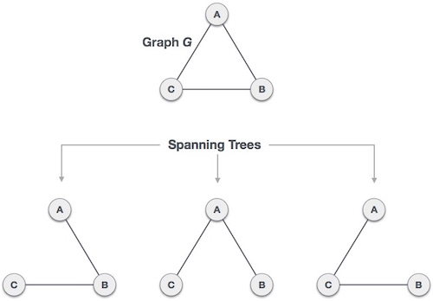
Spanning Tree
A spanning tree is a subset of Graph G, which has all the vertices covered with minimum possible number of edges. Hence, a spanning tree does not have cycles and it cannot be disconnected..
By this definition, we can draw a conclusion that every connected and undirected Graph G has at least one spanning tree. A disconnected graph does not have any spanning tree, as it cannot be spanned to all its vertices.
We found three spanning trees off one complete graph. A complete undirected graph can have maximum n^{n-2} number of spanning trees, where n is the number of nodes. In the above addressed example, n is 3, hence 3³⁻² = 3 spanning trees are possible.

Slide 23
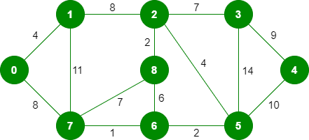
Minimum Spanning Tree (MST)
In a weighted graph, a minimum spanning tree is a spanning tree that has minimum weight than all other spanning trees of the same graph. In real-world situations, this weight can be measured as distance, congestion, traffic load or any arbitrary value denoted to the edges.
Kruskal’s Minimum Spanning Tree Algorithm
Step1: Sort all the edges in ascending order of their weight.
Step 2: Pick the smallest edge. Check if it forms a cycle with the spanning
tree formed so far. If cycle is not formed, include this edge. Else, discard it.
Step3: Repeat step#2 until there are (V-1) edges in the spanning tree.

Slide 24
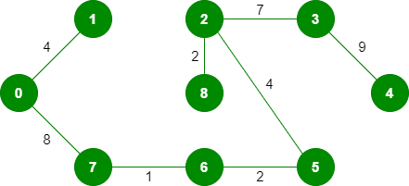
The graph contains 9 vertices and 14 edges. So, the minimum spanning tree formed will be having (9 – 1) = 8 edges.
After sorting:
Weight Src Dest
1 7 6
2 8 2
2 6 5
4 0 1
4 2 5
6 8 6
7 2 3
7 7 8
8 0 7
8 1 2
9 3 4
10 5 4
11 1 7
14 3 5

Slide 25
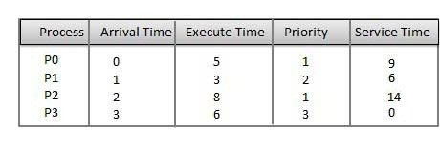
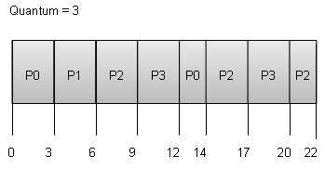
Round Robin Scheduling
Round Robin is the preemptive process scheduling algorithm.
Each process is provided a fix time to execute, it is called a quantum.
Once a process is executed for a given time period, it is preempted and other process executes for a given time period.
Context switching is used to save states of preempted processes.

Slide 26
Process | Wait Time : Service Time - Arrival Time
P0 | (0 - 0) + (12 - 3) = 9
P1 | (3 - 1) = 2
P2 | (6 - 2) + (14 - 9) + (20 - 17) = 12
P3 | (9 - 3) + (17 - 12) = 11
Wait time of each process is as follows −
Average Wait Time: (9+2+12+11) / 4 = 8.5

Slide 27
Dijkstra’s algorithm
Dijkstra’s algorithm is the iterative algorithmic process to provide us with the shortest path from one specific starting node to all other nodes of a graph
Dijkstra’s algorithm is only applicable when all weights are positive because, during the execution, the weights of the edges are added to find the shortest path.
Dijkstra's algorithm makes use of weights of the edges for finding the path that minimizes the total distance (weight) among the source node and all other nodes. This algorithm is also known as the single-source shortest path algorithm.

Slide 28
Algorithm
The very first step is to mark all nodes as unvisited,
Mark the picked starting node with a current distance of 0 and the rest nodes with infinity,
Now, fix the starting node as the current node,
For the current node, analyze all of its unvisited neighbors and measure their distances by adding the current distance of the current node to the weight of the edge that connects the neighbor node and current node,
Compare the recently measured distance with the current distance assigned to the neighboring node and make it as the new current distance of the neighboring node,
After that, consider all of the unvisited neighbors of the current node, mark the current node as visited,
If the destination node has been marked visited then stop, an algorithm has ended, and
Else, choose the unvisited node that is marked with the least distance, fix it as the new current node, and repeat the process again from step 4.

Slide 29
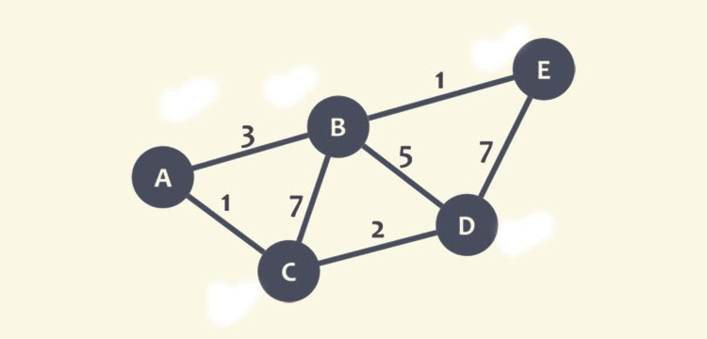
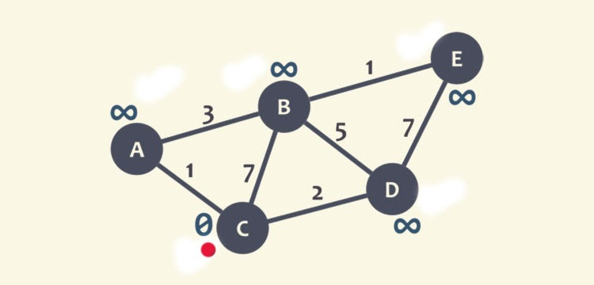
Working example of Dijkstra Algorithm

Slide 30
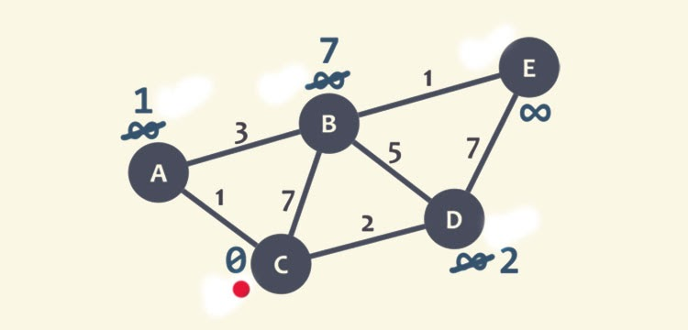
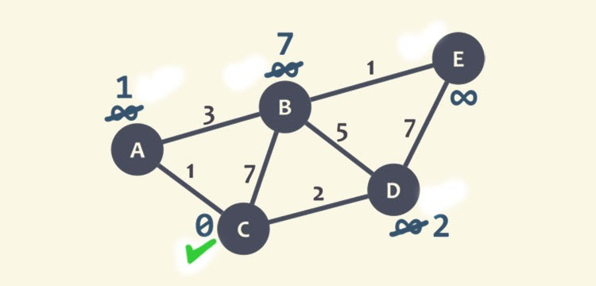
Marked Node C as visited

Slide 31
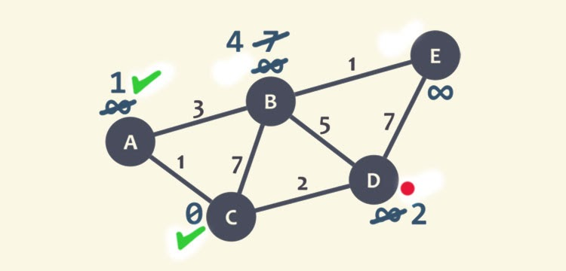
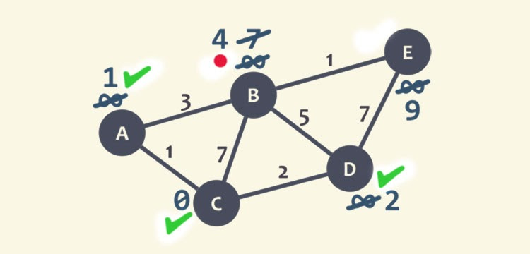
Graphical Representation of Node D as Current Node

